Slide 1
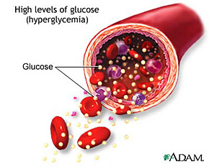
Diabetes Complications

Slide 2
Micro- Complications
Eye
Kidney
Feet
Macro- Complications
Heart
Brain
Feet

Slide 3
HbA1c
Normal HbA1c
High HbA1c
RBC
Glucose

Slide 4
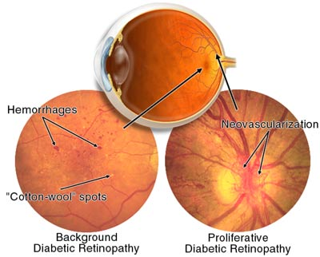
Diabetic Retinopathy
Notes:
Retinopathy
Damage to the retina
Thin layer of tissue at the back
of the eye contains small blood
vessels and nerve endings for vision
Minor changes are very common after
10-15 years of diabetes
Eye screening: At least every 2 yrs
Non-proliferative / background retinopathy
Capillaries in the back of the eye balloons & form pouches
Fluid leakage leads to macular oedema (build-up of fluid)
Proliferative retinopathy
Can threaten vision
Blood vessels become so damaged they close off and new weaker vessels form
Scar tissue is formed (as a result of the damage) and the surrounding tissue shrinks which can pull the retina, causing retinal detachment
Progression of retinopathy is related to poor diabetes control and long duration of diabetes
Can be treated by laser treatment or may require surgery for complications

Slide 5
Other eye diseases
Blurred Vision
Notes:
Blurred vision: due to the lens shape changes that occur due to high BGLs
Cataracts: clouding of the eye’s lens, blocking light
Glaucoma: increased
pressure in the eye;
if untreated can lead to
blindness

Slide 6

Eye Screening

Slide 7
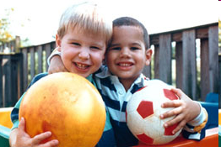

Normal vision vs retinopathy vision

Slide 8
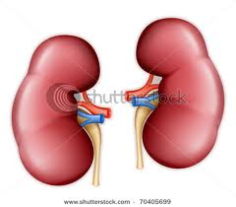

Diabetic Nephropathy
Filtering system (like a colander)
Excrete waste products
High BGLS places extra pressure on the filters → leakage of reusable nutrients.
Complications:
Proteins in urine → kidney damage.

Slide 9
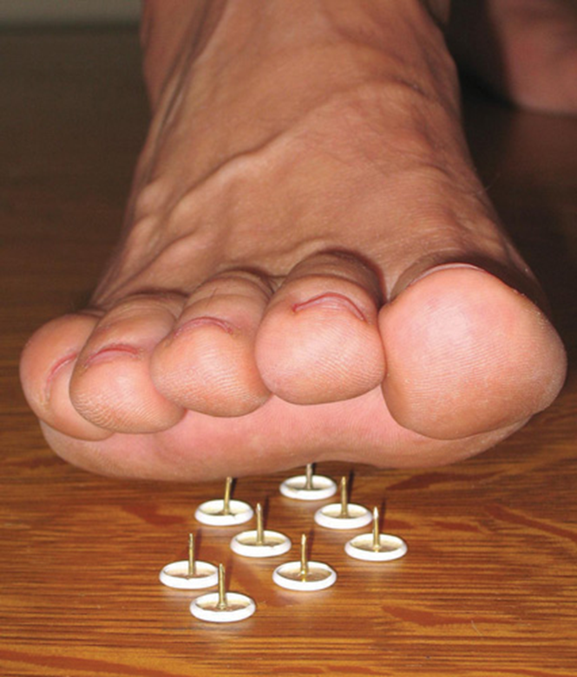
Nerve damage
Signs & Symptoms:
Reduced ability to feel pain
Numbness, tingling, shooting or burning pains
Skin changes i.e. dry, peeling, cracking
Calluses forming on high pressure points

Slide 10
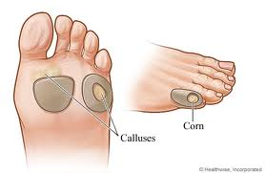
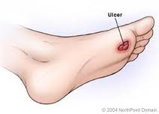
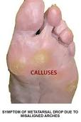
Nerve Damage
Skin changes i.e. dry, peeling, cracking
Calluses forming on high pressure points
Foot ulcers
Poor circulation: narrowed & hardened blood vessels; less ability to fight infection & to heal; cold feet; claudication
Amputation

Slide 11
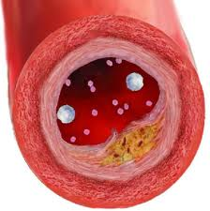
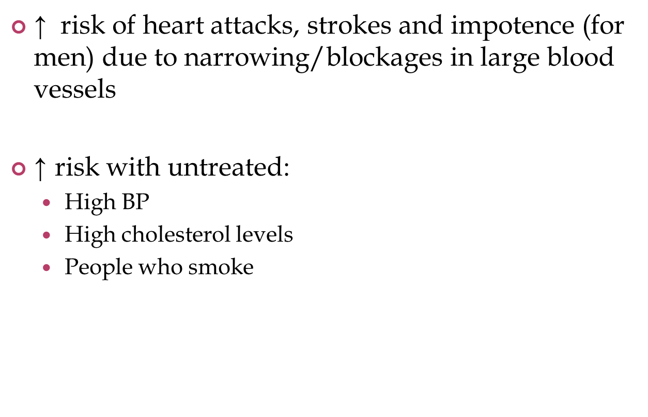
Vascular disease

Slide 12
Targets for prevention
Target 1: Blood Glucose Levels (BGL) 4 to 8 mmol/L
Target 2: HbA1c ≤ 7 %
Target 3: Blood pressure (BP) ≤130/80 mmHg
Target 4: Cholesterol TC <4.0 mmol/L; HDL >1.0 mmol/L;
LDL <2.5 mmol/L; TG <1.5 mmol/L
Target 5: Eyes At least every 2 years
Target 6: Feet Annual checks
Target 7: Kidneys Annual checks
Urinary albumin excretion:
<20µg/min (overnight collection), <20mg/L (spot collection)
<3.5 mg/mmol: women, <2.5mg/mmol: men (ACR)

Slide 13
Complications screening
BP : At least twice a year
Lipids: At first age group clinic following diagnosis (within 6months diagnosis) and every 5 years if pre-pubertal and every 2 years from age 12
Microalbuminuria:
- All patients aged 11 years and over (or)
- At age <11 yrs age if diabetes duration >= 5 years.

Slide 14
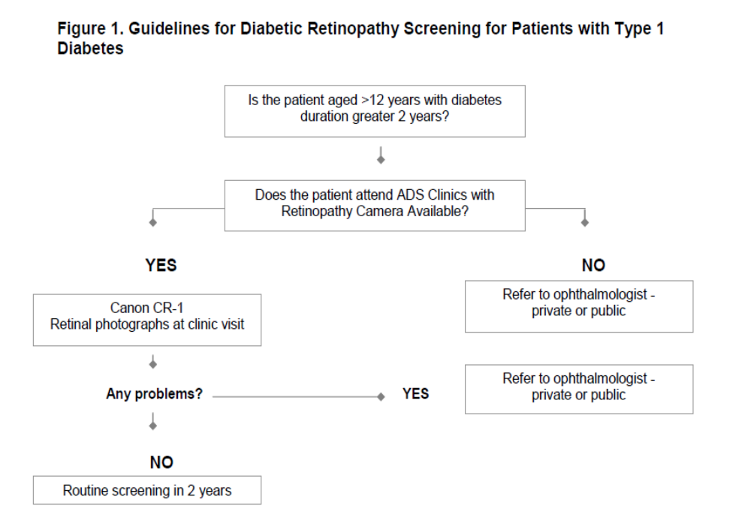

Slide 15
Thank you
Any Questions?

